Slide 1
Indian Removal
Unit 6: Growth & Expansion

Slide 2
Creek Indians
Sometimes called Muscogee Indians
Wanted to fight to preserve land.
lived in mound building societies along large rivers, creeks and plains.
Tribal towns were made up of self- governing systems.
were independent from one another and made allies only in time of war.

Slide 3
Creek Indians
Divided into two factions
Red sticks
wanted war
led by Alexander McGillivray
White sticks –
wanted peace
led by William McIntosh
Red Sticks
White Sticks
Those Who Wanted War
Those Who Wanted Peace

Slide 4
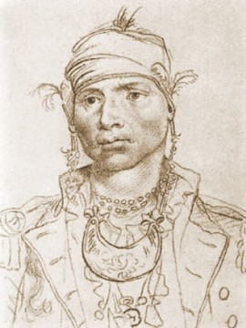
Alexander McGillvray
Interpreter and Chief for the Creek Indians.
Mother was a Creek who raised him as a full member of the Wind Clan.
Father was a Scottish trader who had him educated in Charleston, SC.
Supported the British during the Revolutionary War as an officer.
Ceded land near the Oconee River in 1790

Slide 5
Oconee Wars
The Oconee Wars started when settlers (pioneers) began to move onto Creek lands along the Oconee River.
Small battles were fought between the settlers and Creeks.

Slide 6
The Creek War
Fought primarily against General Andrew Jackson (eventual president)
Red Sticks massacred many Americans at Fort Mims.
1,000 Red Sticks attacked Fort Mims.
About 400 people, including women and children, died at the hands of the Red Sticks.

Slide 7
The Creek War
The Battle of Horseshoe Bend, in Alabama, ended the Creek War in 1814; Andrew Jackson led the U.S. troops
The Creeks were forced to give up nearly all their land to the U.S. government
Governor Troup pressured the federal government to make a deal with the Creeks.
The Treaty of Indian Springs ceded the last of Creek lands in Georgia to the U.S.
By 1827, the Creeks relocated to the wilderness across the Mississippi River

Slide 8
William McIntosh
Scottish father William/ Creek mother Senoya
Wind clan/ Creek chief
McIntosh received a European education in Savannah.
Encouraged Creek Indians to adopt the colonist ways to own property, grow cotton, and own slaves.
McIntosh supported Andrew Jackson in the Creek Indian Wars.
Participated in signing the Treaty of Indian Springs of 1821 which ceded the Creek’s remaining land in Georgia
Assassinated by a group of Red Stick Creeks for signing the Treaty of Indian Springs
Governor Troup’s first cousin

Slide 9
The Cherokee Nation
The Cherokee occupied the Northern 1/3rd of Georgia and extended into 3 other states.
They saw the Creek driven from their lands and were determined to be different.

Slide 10
Cherokee Nation
Wished to show that they were “civilized” like whites.
Created an advanced society with an independent government, capital city of New Echota, and a constitution
Sequoyah – developed the Cherokee SYLLABARY.
First native written language.
Used it to create a library.

Slide 11
Cherokee Nation
Cherokee Phoenix
Cherokee Newspaper.
Was bilingual (written in Cherokee and English)
Edited by Elias Boudinot

Slide 12
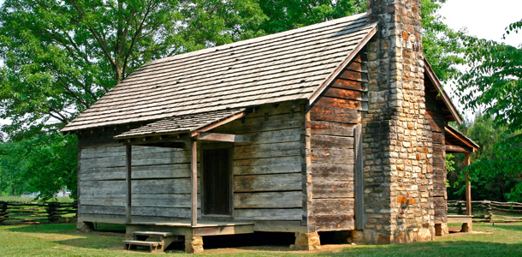
Cherokee Nation
Cherokee Government
New Echota became the capital, which contained a library and printing press.
Created a constitution with three branches of government and bicameral legislature

Slide 13
Cherokee Nation
In 1791, the U.S. government signed a treaty guaranteeing that the Cherokee nation could be independent and have its own government.
In 1828, Georgia lawmakers reversed that agreement, saying that state laws were now in effect in Cherokee lands.

Slide 14
John Ross
Son of a Scottish father and a part-Cherokee, part-Scottish mother
Helped create a Cherokee Constitution.
Argued the case for the Cherokee nation before the Supreme Court
Was unable to convince the U.S. government to rescind (cancel) the Compact of 1802.
Guided the Cherokee through the difficult Trail of Tears march to Oklahoma.

Slide 15
Gold Leads to Conflict
Gold was discovered on Cherokee lands near Dahlonega, GA in1829.
Prospectors rushed there ignoring Cherokee territorial rights.

Slide 16
Indian Removal Act- 1830
President Andrew Jackson supported Georgia’s interests in removing the Cherokee from their land.
The Indian Removal Act was enacted to remove all Indians from Georgia and settle them on land west of the Mississippi.

Slide 17
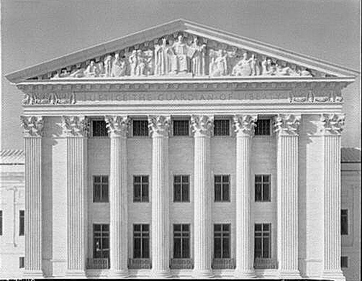
Worcester v. Georgia
U.S. Supreme Court case to decide if the Cherokee had the right of sovereignty.
Chief Justice John Marshall decided in the Cherokee’s favor.
President Andrew Jackson refused to enforce the ruling and ordered that the Indians be removed.
Georgians ignored the ruling and continued to move into Cherokee lands.

Slide 18
Trail of Tears
John Ross and his people held out until the U.S. sent troops in 1838.
The troops rounded them up and sent them to the Oklahoma Territory. (approx. 14,000 Cherokee)
It was winter during the 800 mile walk.

Slide 19
Trail of Tears
An estimated 4,000 Cherokee died from harsh weather conditions, disease and lack of food during the six-month trek.
Elias Boudinot, Major Ridge, and his son were executed for their part in signing the Treaty of New Echota, which gave up the last of the Cherokee land in Georgia

